Slide 1


Oracle database
Lecture 19

Slide 2

Today’s Agenda
Outer Join
Types Of Outer Joins
ANSI Syntax For Join
Natural Join
Non-Equi Join

Slide 3
Outer Join
An outer join is similar to an equijoin because it returns all the records an equijoin returns.
But it also returns records that are in one of the tables with no matching records in another table.

Slide 4
Outer Join
To understand , this consider the following 2 tables:
EMP
EmpNo
Ename
Age
EMP_SKILLS
Ename
Skills
This table holds the information about all the
employees of the company and has one row
each for every employee
This table holds the information about the skills
an employee has. Some employees have more
than one skill , while some may not have any
skill at all.

Slide 5
Outer Join
Now , suppose we have to print entire details of every employee along with the skills if he has them.
Now , suppose we write the following query for this:
Select e1.empno,e1.ename,e1.age,e2.skills
From emp e1,emp_skills e2
Where e1.ename=e2.ename;
The above query will return only those rows where a match for the ENAME column is found in both the EMP and EMP_SKILLS tables.

Slide 6
Outer Join
But , some Employees will not be included in the result because there are no matching ENAME in the EMP_SKILLS table.
To solve this issue we use OUTER JOIN.
An OUTER JOIN returns not only results which satisfy all conditions, but also returns rows from one table which did not satisfy the condition.

Slide 7
Outer Join
In case of OUTER JOIN to work we first have to identify the deficit table.
A table is called a DEFICIT TABLE if it does not contain a matching value in the join column as compared to the value of other table.
In simple terms , in our example EMP_SKILLS is the DEFICIT TABLE because there can be some ENAME in EMP for which there is no match in the EMP_SKILLS table.

Slide 8
Outer Join
Now , while writing the OUTER JOIN query the entire syntax is same as that of EQUI JOIN , but we place a + along with the column of DEFICIT TABLE in the JOIN CONDITION.
So in our case the query will be:
Select e1.empno,e1.ename,e1.age,e2.skills
From emp e1,emp_skills e2
Where e1.ename=e2.ename(+);
Since we have the NON DEFICIT table on left of join condition ,
this is called LEFT OUTER JOIN

Slide 9
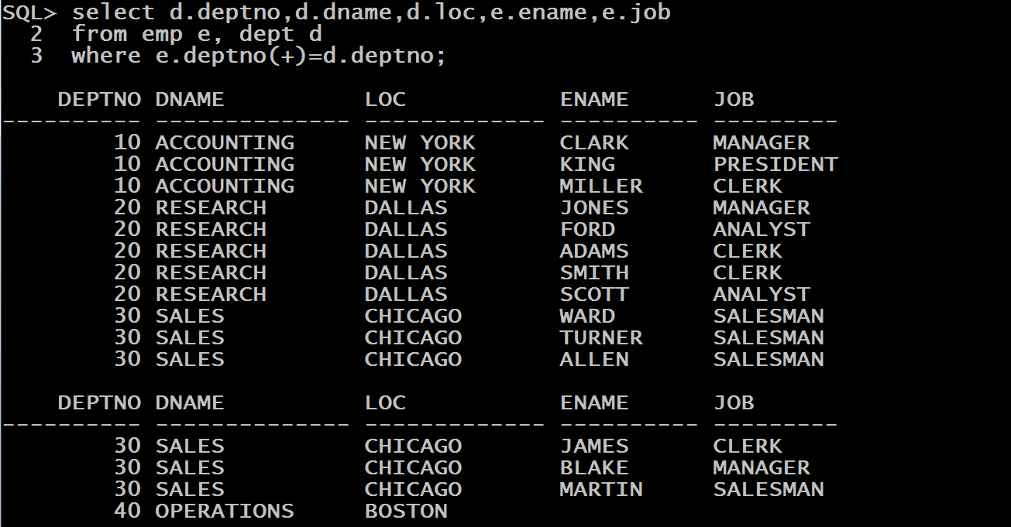
Query
WAQ to display the complete list of all the departments run by the company. Your query should display DEPTNO,DNAME,LOC and ENAME and JOB of the employees in the department , if any.

Slide 10
Oracle’s New Syntax For Joins
From Oracle 9i onwards , Oracle has provided us new syntax for joins.
These are called ANSI JOIN SYNTAX.
Their benefit is that , they make the query more readable as well as support FULL OUTER JOIN which is not supported by traditional syntax of join given by Oracle.

Slide 11
Cross Join
Syntax:
Select <col_names>
From <table 1> CROSS JOIN <table2>;
Example:
Select ename,dname
From emp CROSS JOIN dept;

Slide 12
Equi Join
Syntax:
Select <col_names>
From <table 1> INNER JOIN <table2>
On <table1.col>=<table2.col>
[Where <cond>];
The keyword INNER is optional , so we also can just write JOIN

Slide 13
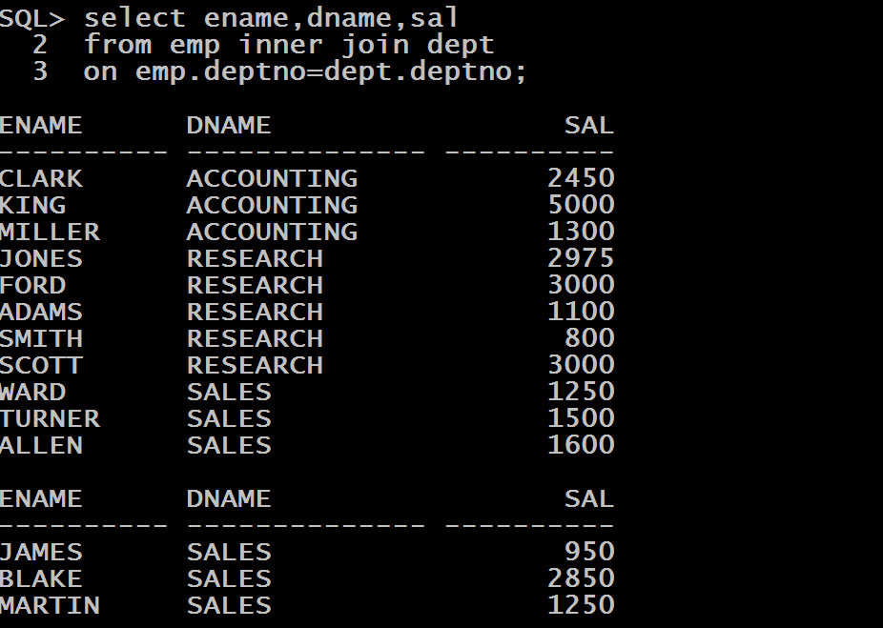
Equi Join
WAQ to display ename ,sal and dname of all the employees in the company

Slide 14
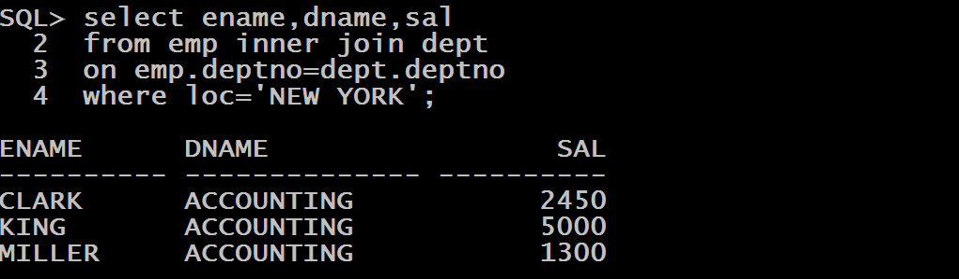
Equi Join
WAQ to display ename ,sal and dname of all the employees who work in NEW YORK.

Slide 15
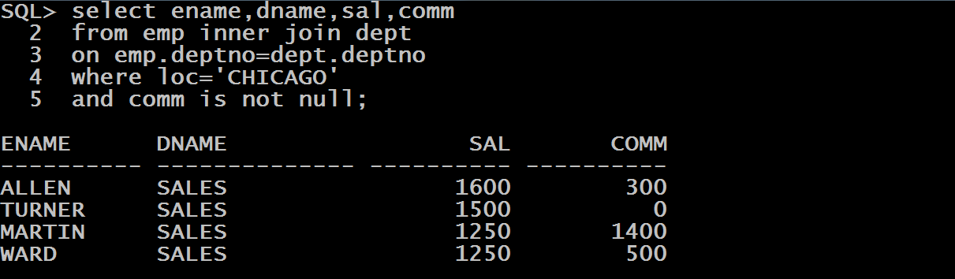
Equi Join
WAQ to display ename , dname, sal and comm of all the employees who work in CHICAGO and get COMMISSION.

Slide 16
Self Join
Syntax:
Select <col_names>
From <table > <alias 1> JOIN <table> <alias 2>
On <alias1.col>=<alias2.col>
[Where <cond>];

Slide 17
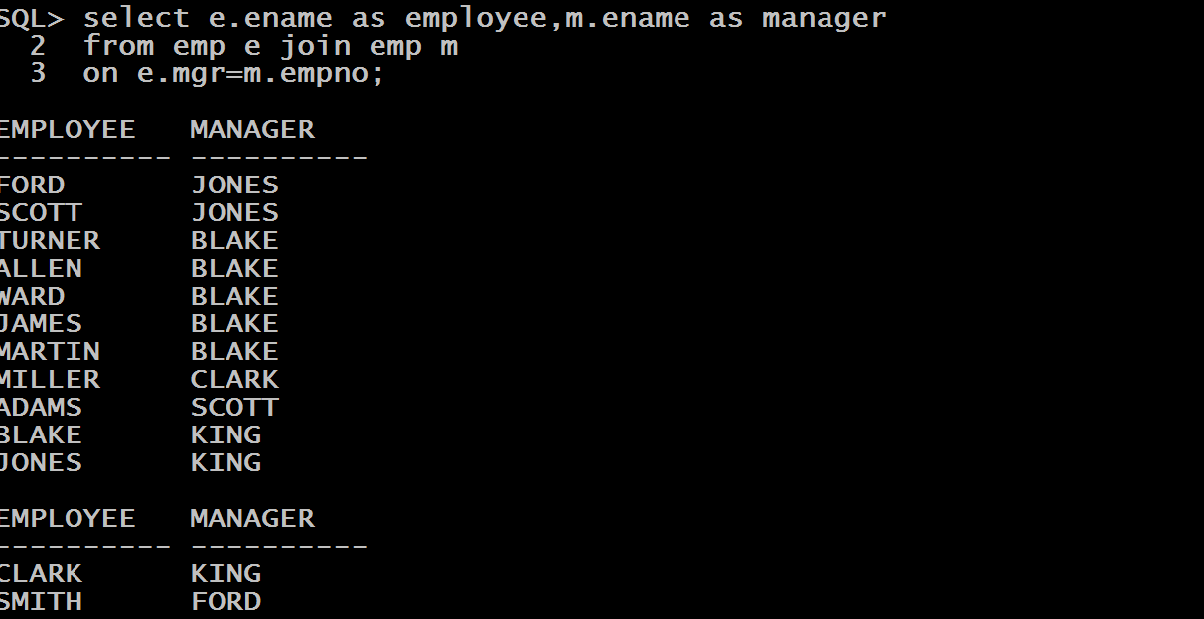
Self Join
WAQ to display name of every employee along with his manager’s name

Slide 18
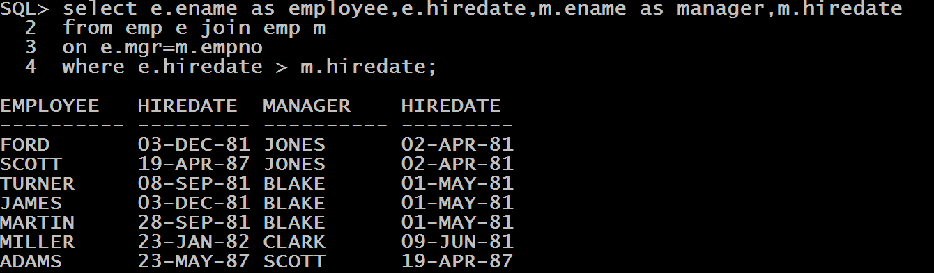
Self Join
WAQ to display name and hiredate of every employee along with his manager’s name and hiredate , of all those employees who were hired after their managers

Slide 19
Left Outer Join
Syntax:
SELECT columns
FROM table1 LEFT OUTER JOIN table2
ON table1.column = table2.column;
In this , the NON –DEFICIT TABLE should remain on left of the keyword LEFT OUTER JOIN

Slide 20
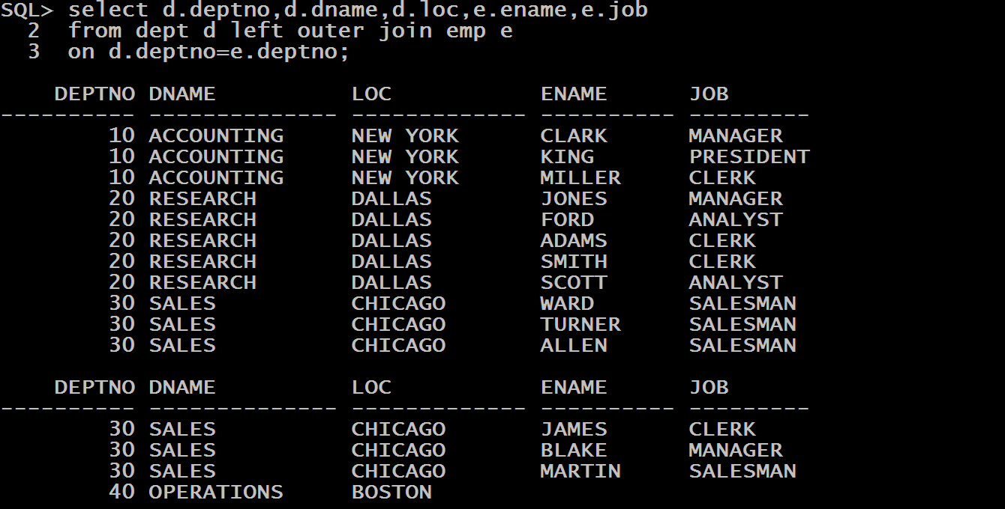
Left Outer Join
WAQ to display the complete list of all the departments run by the company. Your query should display DEPTNO,DNAME,LOC and ENAME and JOB of the employees in the department , if any.

Slide 21
Right Outer Join
Syntax:
SELECT columns
FROM table1 RIGHT OUTER JOIN table2
ON table1.column = table2.column;
In this , the NON –DEFICIT TABLE should remain on right of the keyword RIGHT OUTER JOIN

Slide 22

Right Outer Join
WAQ to display the complete list of all the departments run by the company. Your query should display DEPTNO,DNAME,LOC and ENAME and JOB of the employees in the department , if any.

Slide 23
Full Outer Join
Syntax:
SELECT columns
FROM table1 FULL OUTER JOIN table2
ON table1.column = table2.column;
This type of join returns all rows from the LEFT-hand table and RIGHT-hand table with nulls in place where the join condition is not met.

Slide 24
Full Outer Join
Suppose we have following 2 tables:
SUPPLIER
ORDERS
supplier_id | supplier_name
10000 | IBM
10001 | Hewlett Packard
10002 | Microsoft
10003 | NVIDIA
order_id | supplier_id | order_date
500125 | 10000 | 12-AUG-2013
500126 | 10001 | 13-AUG-2013
500127 | 10004 | 14-AUG-2013

Slide 25
Full Outer Join
WAQ to display the complete list of all the SUPPLIERS and ORDERS , irrespective of whether supplier id’s match or not.
SELECT suppliers.supplier_id, suppliers.supplier_name, orders.order_date FROM suppliers FULL OUTER JOIN orders ON suppliers.supplier_id = orders.supplier_id;
supplier_id | supplier_name | order_date
10000 | IBM | 12-AUG-2013
10001 | Hewlett Packard | 13-AUG-2013
10002 | Microsoft
10003 | NVIDIA
 | <null> | 14-AUG-2013

Slide 26
Natural Join
A natural join joins tables based on the columns with the same name and data type.
Here there is no need to prefix the column name with the table alias, and the join is indicated with the keywords NATURAL JOIN.
There is not even a mention of which column(s) to join.
Any use of the ON clause is also not allowed with the NATURAL JOIN keywords, and the common columns cannot list a table alias.

Slide 27
Natural Join
Syntax:
SELECT columns
FROM table1 NATURAL JOIN table2 ;

Slide 28
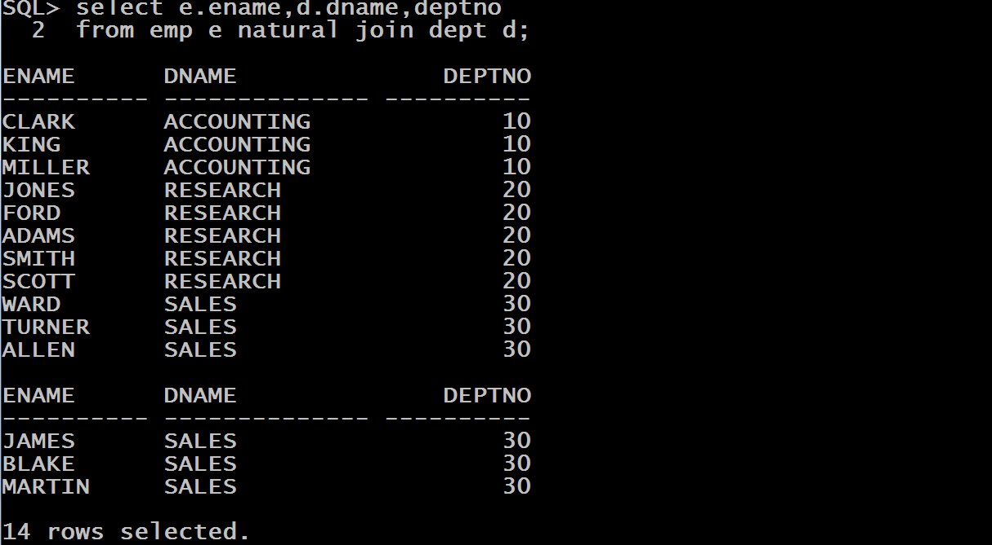
Natural Join
WAQ to display ename ,dname and deptno of all the employees in the company.

Slide 29
Non Equi Join
Non equi joins is used to return result from two or more tables where exact join is not possible.
For example , suppose we have EMP table and SALGRADE table.

Slide 30
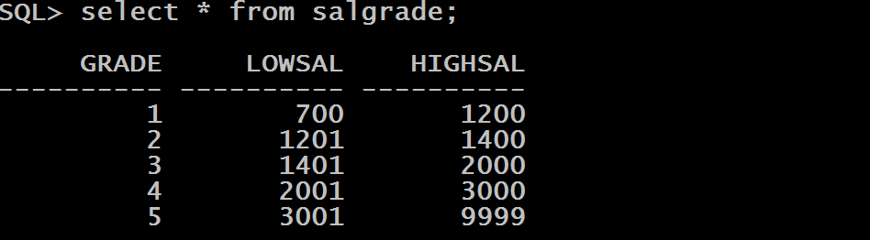
Non Equi Join
The SALGRADE table contains GRADE and their LOW SALARY and HIGH SALARY.

Slide 31
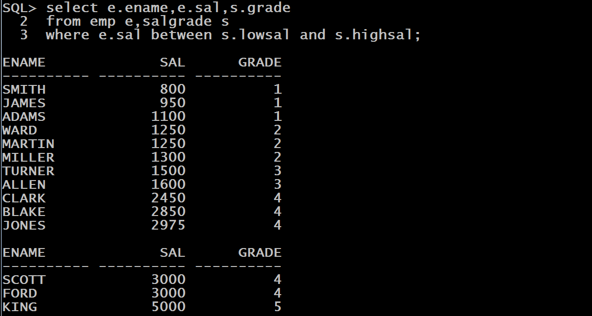
Non Equi Join
Now , suppose we want to find the GRADE of employees based on their salaries then we can use NON EQUI join.

